Slide 1
App Service Web Apps
Chris Pietschmann
Solutions Architect @ Perficient, Inc
MCSD: Azure Solutions Architect
http://BuildAzure.com http://pietschsoft.com
@BuildAzure @crpietschmann
Notes:
<1 min
Good Morning
I’m Chris Pietschmann. I work as a Solutions Architect with Perficient. Perficient is one of the local sponsors of todays event.
I’ve been working with Microsoft Azure since all the way back in 2010.
I am a Microsoft certified Azure Solutions Architect.
You can find me online on my blog at BuildAzure.com as well as on Twitter @BuildAzure

Slide 2
Agenda
What is App Service?
Web Apps
Language Support
Deployment
Source Control Integration
Web Jobs
Site Slots
Scale
Hybrid Connections

Slide 3
Azure App Service
Notes:
< 1min
First let’s talk about, “What is Azure App Service?”

Slide 4


Azure App Service Build and scale great cloud apps
Web Apps
Mobile Apps
Logic Apps
API Apps
Notes:
< 1 min
Last year Microsoft took the existing Azure Websites and Azure Mobile Services; renamed them to Web Apps and Mobile Apps, and combined them with 2 new offerings (Logic Apps and API Apps) to form the Azure App Service PaaS (Platform as a Service) offering
It’s the only cloud service that integrates everything you need to quickly and easily build web and mobile apps for any platform and any device.

Slide 5
App Service - one integrated offering
Web Apps
Mobile Apps
Web apps that scale with your business
Build Mobile apps for any device
LOGIC Apps
API Apps
Automate business process across SaaS and on-premises
Easily build and consume APIs in the cloud
Notes:
< 2 min
Let’s cover what each of these are:
Web Apps –
Web Apps allows you to quickly create and deploy web applications that can be easily scaled. This is the most widely used App feature of App Service. Not only can you host custom-built apps, but also many open source apps as well; like Wordpress, Umbraco, DotNetNuke, and many others.
Mobile Apps –
Mobile Apps offers a highly scalable, globally available mobile application development platform for building cloud connected Apps.
Logic Apps –
Logic Apps allow you to easily automate business processes across SaaS (Software as a Service) and on-premises. This allows you to design workflows that start from a trigger and then execute a series of steps.
API Apps –
API Apps make it easier to build, host, and consume APIs in both the cloud and on-premises. Deploying your API as an API App will allow you to benefit from many built-in features, such as simple access control, and automatic SDK generation.
As Platform as a Service, the underlying Virtual Machines hosting all your Apps are managed for you. This means no manual server maintenance, or OS updates.

Slide 6
Develop apps with…
.NET | Node.js | PHP | Python | Java
Notes:
< 1 min
Being a Microsoft product you can definitely develop Apps using the .NET Framework. However, Microsoft recognizes and embraces that you may be using other platforms and frameworks for your apps.
In addition to .NET based applications, you can also deploy Node.js, PHP, Python and Java applications to Azure App Service as well.

Slide 7
Benefits of App Service
Automatic OS patching
Enterprise-grade security
High availability
Automated scale out/in
Built-in load balancing
Supports many languages and platforms
.NET, Node.js, Python, Ruby and many more
Easy continuous deployment
Continuous delivery from third-party source control providers
Notes:
< 1 min
Other than just hosting Apps and offering the various Platform as a Service features, there are many additional benefits offered by App Service.
These include:
Automatic OS patching
Enterprise-grade security
Automated scaling and built-in load balancing
Multi-language and platform support
Support for easy continuous deployment

Slide 8



Web Apps
Logic Apps
Mobile Apps
Administration App
Customer site
Order Completed
Customer App
http
SQL
API Apps
Notes:
< 1 min
Here’s a simple, high level example of an enterprise system built on top of Azure App Service.
At the base there API Apps securely exposing data from various other enterprise systems.
Above that, the Customer website is hosted as a Web App, along with Mobile Apps for both Customer and Administration Apps.
There’s also Workflow integration using Logic Apps.
All 4 Apps features offer different functionality, and compliment each other allowing for complex systems to be built much easier. Plus you get the other many benefits of Azure App Services.

Slide 9
Web Apps
Notes:
< 1 min
Web Apps is the feature we’ll focus on primarily, given the short amount of time we have. I want to make sure you have enough time to play with the hands-on labs.

Slide 10
Full capability set available including:
.NET, Node.js, Java, PHP, and Python
WebJobs for long running tasks
Integrated VS publish, remote debug…
CI with VSTS, GitHub, BitBucket
Auto-load balance, Autoscale, Geo DR
Virtual networking and hybrid connections
Site slots for staged deployments
Web Apps
Web apps run as-is
no changes required

Slide 11
Demo: Creating a Web App

Slide 12
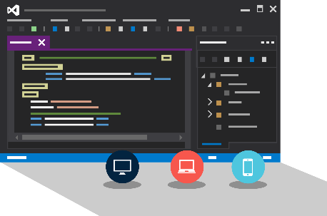
Visual Studio + App Service Web Apps
Create Azure Resources during File / New
Create Web App during deploy
Manage with Server Explorer
Notes:
Skip?

Slide 13
WebJobs

Slide 14






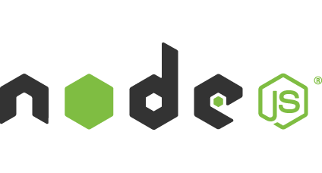

Light-weight CPU Intensive Tasks
run.cmd, run.bat
run.exe
run.ps1
run.sh
run.php
run.py
run.js
Job Type:
On-Demand, Scheduled, Continuous
Scale:
Singleton, Multi-instance
WebJobs SDK Feature:
BlobTrigger, TableTrigger, QueueTrigger, ServicebusTrigger
Deployment:
Portal, Visual Studio, CLI, Git

Slide 15

WebJobs
Web App

Slide 16
WebJobs
Web App

Slide 17
Demo: WebJobs

Slide 18
API Apps

Slide 19
Easily use cloud or custom APIs:
Dozens of built-in APIs for popular SaaS
An ecosystem of APIs for any need
Create and publish custom, reusable APIs
Visual Studio tooling with one click publish and remote debugging
Automatic client SDK generation for many languages
Api Apps
Create, consume and
host APIs more easily

Slide 20
Benefits of API Apps
Bring your API as-is
.NET Web API
Node.js + Express
Java
PHP
Many other technologies
Connect easily to SaaS platforms

Slide 21
API Apps addresses key pains around building and consuming APIs
Build your API
Consume APIs
Web Apps++: Bring you API as is in your language of choice
API discovery
SDK generation
SSO, handled by server
Authentication, built-in to mobile and web SDKs
Expose enterprise APIs
Microservice style
Metadata contract
SSO
Simple access control
Gallery – public & organization

Slide 22
Enterprise connectivity
Dynamics
SQL
SAP
Oracle

Slide 23




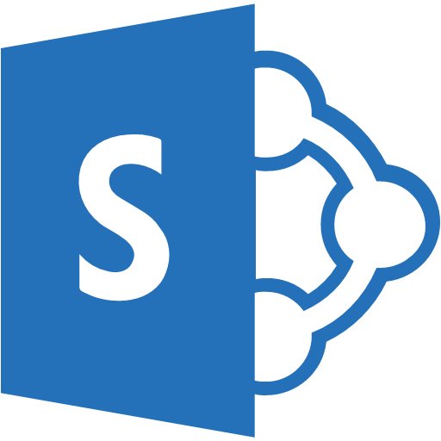

Simplifying Integration
Azure API Apps - Managed Middle Tier
API App[s]
On Premise Applications
Databases in Azure VMs
SharePoint Online
Cloud-Hosted Web Apps
SSO, Auth, Scale, etc.

Slide 24
Logic Apps

Slide 25
New Logic Apps for easy automation
No code designer for rapid creation
Dozens of pre-built templates to get started
Out of box support for popular SaaS and on-premises apps
Use with custom API apps of your own
Biztalk APIs for expert integration scenarios
LOGIC Apps
Automate SaaS and
on-premises systems

Slide 26
SaaS integration

Slide 27
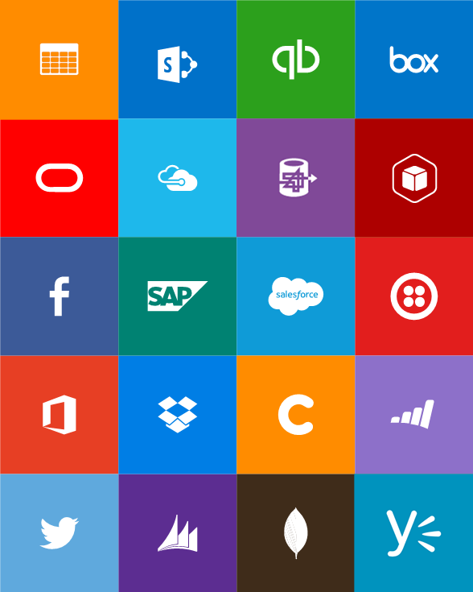
Built-in API Connectors
Connectors
Box
Chatter
Delay
Dropbox
Azure HD Insight
Marketo
Azure Media Services
OneDrive
SharePoint
SQL Server
Office 365
Oracle
QuickBooks
SalesForce
Sugar CRM
SAP
Azure Service Bus
Azure Storage
Timer / Recurrence
Twilio
Twitter
IBM DB2
Informix
Websphere MQ
Azure Web Jobs
Yammer
Dynamics CRM
Dynamics AX
Hybrid Connectivity
Protocols
BizTalk Services
HTTP, HTTPS
File
Flat File
FTP, SFTP
POP3/IMAP
SMTP
SOAP + WCF
Batching / Debatching
Validate
Extract (XPath)
Transform (+Mapper)
Convert (XML-JSON)
Convert (XML-FF)
X12
EDIFACT
AS2
TPMOM
Rules Engine

Slide 28
Target audience is anyone who can use Azure
… but not necessarily business users or consumers

Slide 29
Mobile Apps

Slide 30
New capabilities for Mobile apps:
Webjobs for long running tasks
CI with VSTS, GitHub, BitBucket
Auto-load balance, Autoscale, Geo DR
Virtual networking and hybrid connections
Site slots for staged deployments
Mobile Apps
Mobile services plus
a whole lot more

Slide 31







Azure Mobile Apps
Storage
Authentication
Logic
Push
Scheduler
Notes:
Speaking Notes
Summarize earlier slide
Azure Mobile Services is a Backend-as-a-Service
Instead of you having to design, build, test, deploy, manage, and upgrade your whole backend, we do it for you
Features of Mobile Services
Storage – SQL DB
Authentication – built in support for social providers w/ ability to custom auth
Backend logic – data validation, logical flows, etc
Push Notifications – across all major mobile platforms
Scheduler – backend job processing

Slide 32
AutoScale

Slide 33
AutoScale
Web App

Slide 34
AutoScale
Web App

Slide 35
AutoScale
Web App

Slide 36
Application Insights

Slide 37
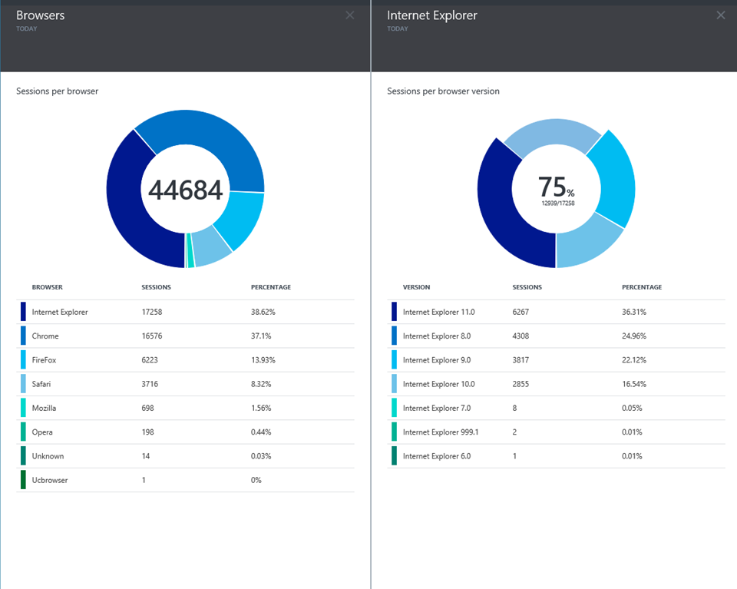
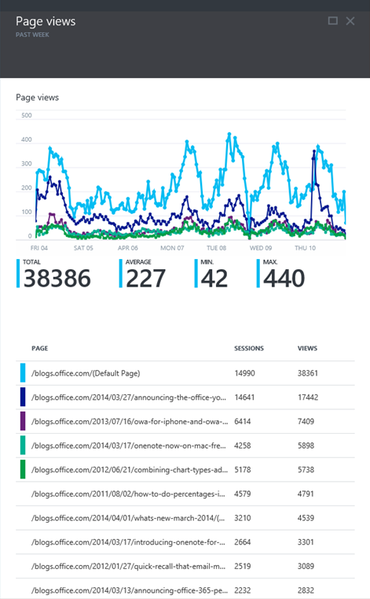
Application Insights
Application Insights
Notes:
Logging
Diagnostics
Analysis

Slide 38

App Service Hands-on Labs:
Lab: Get started with Web Apps and ASP.NET
http://bit.ly/MkeAzureWebApp
Alternate Lab: Build Mobile App with Web Client
http://bit.ly/MkeAzureMobileApp
Todays Agenda:
http://bit.ly/MkeAzureBootcamp
Chris Pietschmann
@BuildAzure http://BuildAzure.com

Slide 39

#GlobalAzure http://bit.ly/MkeAzureBootcamp

